Slide 1
Coursework title: Are Mr and Mrs Bennet Good Parents in your opinion? Examine the portrayal of marriage in the novel Pride and Prejudice by Jane Austen.
What makes a good parent?
What reasons do people get married for?

Slide 2
In this essay I will be considering whether Mr and Mrs Bennet are good parents and examining how Jane Austen portrays marriage .
To begin with we must define what the ideal good parents are. Good parents are . . .
We must also consider some of the reasons people get married . . .
In the first chapter a great deal about Mr and Mrs Bennet is revealed we find out that Mr Bennet is . . . .His attitude towards his family seems . . .
Mrs Bennet is described as . . . Her attitude towards her daughters is . . . Here attitude towards marriage seems to be . . .
The daughters must have been influenced by their parents . . .
Elizabeth says about marriage . . .

Slide 3
Mrs Bennet’s plan for Jane – travelling by horse in the rain.
Mary’s insistence on singing and playing and Mr Bennet’s handling of the situation.
Mrs Bennet’s boasting about Jane at Mr Bingley’s ball.
Lydia and Kitty’s behaviour at Mr Bingley’s ball.
Charlotte Lucas accepting Mr Collin’s proposal. Include her attitude towards marriage (unromantic / practical)

Slide 4
Elizabeth’s attitude to marriage (only the deepest love and respect would induce her . . ) Mr and Mrs Bennet’s handling of Elizabeth’s refusal to marry Mr Collins.
Lydia’s elopement with Wickham (impulsive marriage . . . To show off and appear grown up . . .without thought)
Jane’s wish to please everyone (her family) by making a good marriage.

Slide 5
Elizabeth refuses to accept Mr Darcy’s proposal of marriage because of his treatment of Wickham and because he helped split up Jane and Bingley.
Mr and Mrs Bennet (foolishly) allow Lydia to go and stay with Wickham’s regiment in Brighton (as the guest of Mrs Forster). Lydia elopes with Wickham!
Mr Bennet is unable to find Lydia or save the family’s reputation from the scandal of Lydia’s elopement. None of his girls has much chance of making a good marriage now because . . . .
Elizabeth bumps into Darcy whilst visiting Pemberly (Darcy’s extensive home).

Slide 6
Darcy finds out about Wickham’s behaviour and makes him marry Lydia (as well as paying off his debts).
Elizabeth finds out about Darcy’s good deeds and finally falls in love with him.
Charles Bingley returns from London and proposes to Jane. Bingley and Jane are married at the same time as Darcy and Elizabeth.
Everyone lives happily ever after.

Slide 7
Pride and Prejudice
Jane Austen

Slide 8
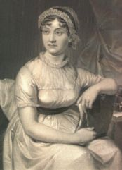
Jane Austen (1775-1817) was a novelist.
She wrote 10 novels (which were well received at her time):
Sense and Sensibility (published anonymously 1811)
Pride and Prejudice (published anonymously 1813)
Mansfield Park (published anonymously 1814)
Emma (published anonymously 1816)
Northanger Abbey (published after her death)
Persuasion (published after her death)
Juvenilia I, II & III (short stories, published after her death)
Lady Susan (published after her death)
The Watsons (published after her death)
Sanditon (published after her death)
It was only after her death that she was known to be the author of these novels.

Slide 9
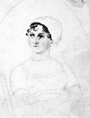
She was born in 1775 at the rectory of Steventon near Basingstoke as the daughter of a clergyman. She was well educated for a woman of her time. She lived a happy if uneventful life.
In 1801 her family went to Bath, where many scenes from her novels takes place. After the death of her father the family moved to Southampton and later to Chawton in Hants, where she wrote most of her novels.
In 1817 a tendency to consumption manifested itself, therefore in May that year she moved to Winchester, where she could get some skilled medical attendance, but she died there two months later.

Slide 10
Pride and Prejudice
CHARACTERS

Slide 11
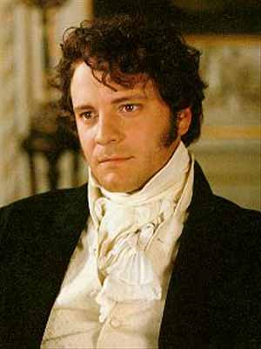
Darcy
Generally serious and formal, yet simple, clear and restrained. While being intelligent and decided in his judgements, he avoids pomposity. He acknowledges that his personality, and hence style, lacks ease making him seem at times rude or ill-mannered.

Slide 12
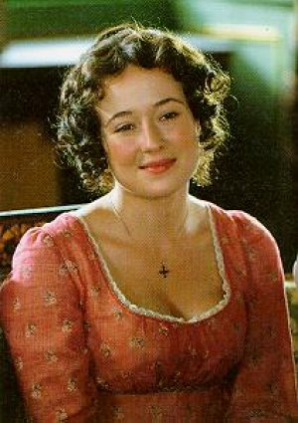
Elizabeth Bennet
Intelligent, with wit in her speech that ranges in style from playfully humorous to argumentative to the coldly formal. She has the wildest stylistic range of any character; reflecting her own changing and understanding.

Slide 13
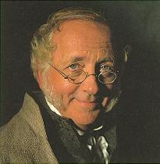
Mr Bennet
“Mr. Bennet was so odd a mixture of quick parts, sarcastic humor, reserve, and caprice, that the experience of three-and-twenty years had been insufficient to make his wife understand his character.”
Mr Bennet’s sarcastic wit is the main feature of a man who has withdrawn from active involvement in his marriage. His disappointment manifests itself by negative mockery and cynicism.

Slide 14
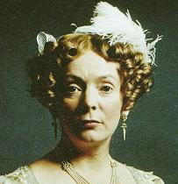
Mrs Bennet
“Her mind was less difficult to develop. She was a woman of mean understanding, little information, and uncertain temper. When she was discontented, she fancied herself nervous. The business of her life was to get her daughters married; its solace was visiting and news.”
Mrs Bennet’s rapid, broken sentences, frequent exclamations and lack of coherence display her lack of rational thought and her inability to distinguish the trivial from the important.

Slide 15
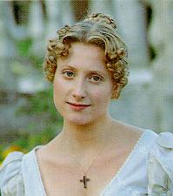
Jane Bennet
Jane’s clear, balanced speech shows frequent use of positives in her praise of everyone which reflects her characteristic "fault" of never "seeing a fault in anyone."

Slide 16
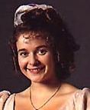
Lydia is almost an exact copy of Mrs Bennet and as such shares her same speech style: loose, exclamatory, self-centred, vain and shallow.
Lydia Bennet

Slide 17
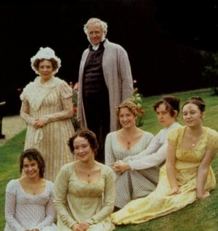
Mr Bennet
The Bennet
Family
Mrs Bennet
Mary Bennet (17)
Jane Bennet (22)
Elizabeth Bennet (20)
Lydia Bennet (15)
Kitty Bennet (16)

Slide 18
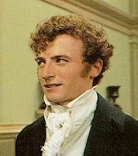
Charles Bingley
A clear general style, though it, like Jane's, has a tendency to be too positive, suggesting a lack of discrimination: "Upon my honour, I never met with so many pleasant girls in my life, as I have this evening; and there are several of them you see uncommonly pretty." (Ch 3).

Slide 19
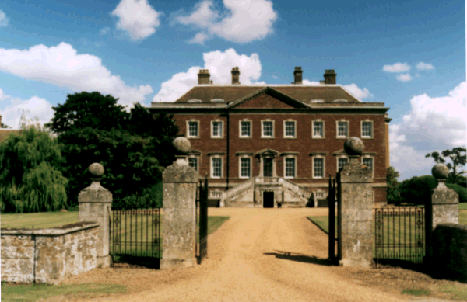
Netherfield
Stately home purhcased
by Charles Bingley

Slide 20

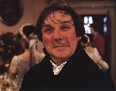
Mr Collins
Stands to inherit The Bennet’s estate as Mr Bennet has no male heir.
His excessive formality and overuse of high-level abstractions shows his pomposity; he can never say a simple thing quickly or simply.
“The garden in which stands my humble abode, is separated only by a lane from Rosings Park, her ladyship's residence. The chimney-piece in the second drawing room alone at Rosings cost in excess of eight hundred pounds..."

Slide 21
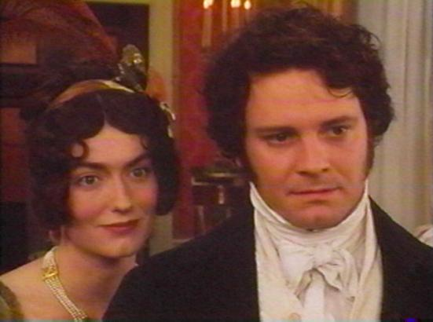
Miss Caroline Bingley
Miss Bingley is described as a fashionable, "very fine lady", has the power to be agreeable, "all that was affectionate and insincere", but her characteristic speech form is the sly dig or insult.

Slide 22
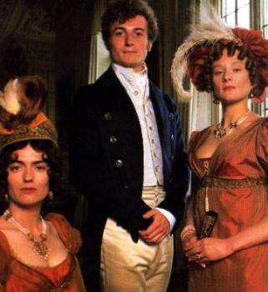
Mrs Hurst
Sister to Charles and Caroline Bingley. Married to the indolent Mr Hurst. She is every bit as snobbish as her sister and most disapproving of the Bennet family as a prospective connection for her brother.

Slide 23
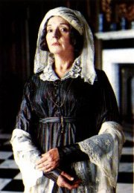
Lady Catherine de Bourgh
Her lack of polite manners, frequent use of personal questions and exclamations indicate her overbearing, rude manners. Note her unintentional comedy of such lines as: "If I had ever learnt (music), I should have been a great proficient." Her speech also shows a real ignorance of other people's feelings: "'She (Elizabeth) would be in nobody's way, you know, in that part of the house'... Mr Darcy looked a little ashamed of his aunt's ill-breeding, and made no answer."(Ch 31)

Slide 24
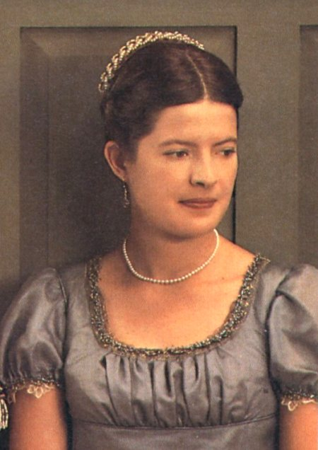
Charlotte Lucas
Friend to Elizabeth Bennet. She agrees to marry Mr Collins after Elizabth refuses his proposal. Charlotte shows Elizabeth that not everyone has the same expectations of life, and marriage in particular.

Slide 25
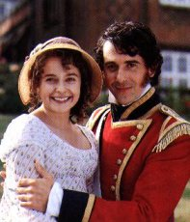
George Wickham
“amiable, clever and agreeable" in speech, he is never rude but deceptive and manipulative. Note his subtle use of emotive terms to gain sympathy and his lack of logic or consistent behaviour.

Slide 26
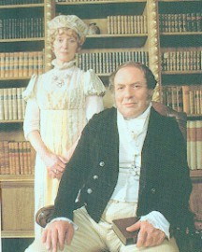
The Gardiners
Mrs Bennet’s brother and his wife prove to be most helpful during both Lydia’s elopement with Wickham and Elizabeth’s accidental visit with Darcy at his Pemberley estate.

Slide 27
Story Summary

Slide 28
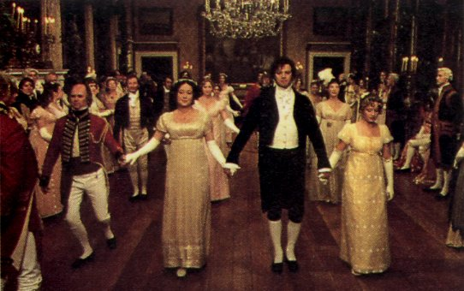
The story begins with the arrival of Mr. Bingley, a rich and eligible young bachelor, and a new neighbour for the Bennet family. Mr. Bingley immediately takes a fancy to Jane, the eldest Bennet daughter, when they meet at a local Assembly Room Ball. He is a pleasant and agreeable man who is soon well-liked by everyone in the community. The general regard for his friend, Mr. Darcy, however is quite the opposite. Although Darcy is also handsome and rich, these qualities are offset by his apparently proud and disagreeable nature.

Slide 29
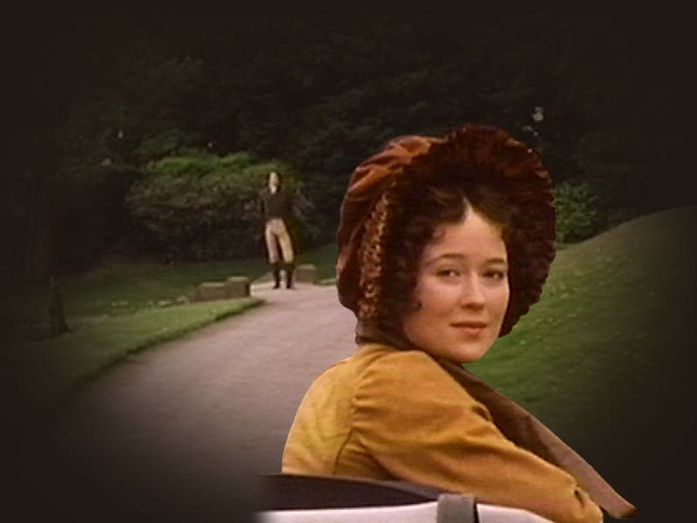
Elizabeth, the second eldest Bennet daughter, has particular reason to dislike him since Darcy slights her at the ball and proclaims that she is "tolerable" but "not handsome enough to tempt" him.
Darcy’s unfavourable opinion of Elizabeth is soon challenged. Despite his initial negative opinion of her and in spite of himself, Darcy begins to find Elizabeth’s playful manners intriguing. He begins to watch her and spends much of his time at the next party staring at her and her "fine eyes".

Slide 30
A little later, Jane is invited to dine with Mr. Bingley’s sisters at Netherfield, the house in which Bingley, his sisters and Darcy are staying. Upon her arrival, she falls ill with a fever and Elizabeth takes it upon herself to go and care for her sister.
As Darcy comes to know her better during the course of her visit, his interest in her increases. His manners, however, are quite abrupt and Elizabeth is convinced that he disapproves of her and continues to view him in an unpleasant light. She finds pleasure only in Mr. Bingley’s company and is relieved when she and Jane return home.

Slide 31
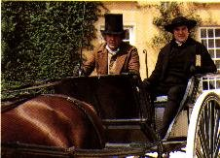
Soon after Jane and Elizabeth return home from Netherfield, Mr. Collins, a cousin of Mr. Bennet and the legal heir to the Bennet estate, arrives for a visit. Mr. Collins is the rector of Hunsford, a small country parsonage, and is under the patronage of Lady Catherine De Bourgh. He turns out to be a pompous and tiresome man who seems to be incapable of much original thought.
The object of Mr. Collins’ visit is to find himself a wife. After learning that Jane may soon be engaged to Bingley, he shifts his attentions to Elizabeth, who is forced to endure his attempts at courtship.
Mr. Collins goes with the Bennet sisters on a walk into Meryton, the nearby town. There, they are introduced to George Wickham, a handsome and charming officer who has just arrived.

Slide 32
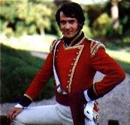
That night, there is a supper party at the Philipses - the aunt and uncle of the Bennet sisters. At the party, Wickham reveals to Elizabeth that he and Darcy grew up together. He then relates a scandalous story about how the present Mr. Darcy ruined his prospects by refusing to give him a valuable church living that had been bequeathed to him in the late Mr. Darcy’s will. Elizabeth is shocked at Mr. Darcy’s callous nature and her dislike of him increases.
The next day, the Bennets receive an invitation from Mr. Bingley and his sisters to a ball at Netherfield. Everyone is pleased and Mr. Collins immediately solicits Elizabeth’s hand for the first two dances. She reluctantly accepts but continues to look forward to the ball.
For Elizabeth, the long-awaited ball does not turn out as expected.

Slide 33
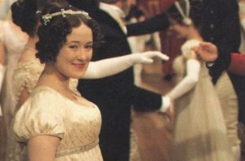
Wickham, with whom she had hoped to dance, does not show up and her dances with Mr. Collins are disastrous. In addition, she is forced to dance with Mr. Darcy after he takes her by surprise in his application for her hand. Later on, she is greatly embarrassed by the unguarded and impolite behavior of her sisters, her mother, Mr. Collins and even her father.
Elizabeth’s troubles do not end with the ball. The next morning, Mr. Collins proposes to her. When she refuses his offer, her mother, Mrs. Bennet, is upset and angry. She tries to force Elizabeth to change her mind but Elizabeth is unmoved. The offended Mr. Collins quickly leaves the house to go dine at the neighbouring Lucas estate.
Less than three days after Mr. Collins’ proposal to her, Elizabeth is shocked to discover that Mr. Collins has made an offer or marriage to Charlotte Lucas, her best friend.

Slide 34
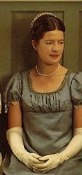
She is even more surprised when she learns that her friend has accepted him. Elizabeth goes to talk to Charlotte but cannot agree with her friend’s explanation for wanting to become Mr. Collins’ wife.
During a visit to Meryton, the local town, Elizabeth meets Wickham again. His explanation, that he decided not to attend the ball since it could have produced an unpleasant scene, satisfies her and she invites him to dine with her family.
During a visit to Meryton, the local town, Elizabeth meets Wickham again. His explanation, that he decided not to attend the ball since it could have produced an unpleasant scene, satisfies her and she invites him to dine with her family.

Slide 35
It is now nearly Christmas and its approach brings Mr. and Mrs. Gardiner (Mrs. Bennet’s brother and sister-in-law) from London for a visit. They all attend a Christmas party at the Philips’ house in Meryton during which Charlotte invites Elizabeth to visit her at the Hunsford Parsonage in March. Wickham, to whom Elizabeth finds herself increasingly attracted, is also at the party. When the Gardiners return to London, they bring a depressed Jane with them in hope that a change of scene will raise her spirits.
After a quiet winter, March finally arrives. Wickham is now courting Miss King, a young lady who has a fortune of 10 000 pounds. He calls on Elizabeth before she leaves to visit Charlotte. She forgives him for his mercenary motives. They part on the promise that they will always be friends.

Slide 36
Elizabeth finds the situation at the parsonage much as she expected. Charlotte is satisfied with her new life but spends as much time as possible away from her husband. They are all invited to dine at Rosings Park, the residence of Lady Catherine De Bourgh who is Mr. Collins patroness and Mr. Darcy’s aunt. Lady Catherine, a dictatorial and impertinent woman, is astonished by Elizabeth’s clever and direct manner of speaking.
The visit to Hunsford passes quietly until, unexpectedly, Mr. Darcy and Colonel Fitzwilliam, his cousin, arrive at Rosings to visit their aunt (Lady Catherine). Elizabeth immediately becomes friends with Fitzwilliam and continues to, unknowingly, attract Darcy’s attention.

Slide 37
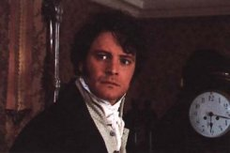
One day, Elizabeth meets Colonel Fitzwilliam during a walk in the woods around Rosings. He reveals to Elizabeth that Darcy boasts of having recently saved his friend Bingley from the inconveniences of a most imprudent marriage. An upset Elizabeth realizes that Darcy was responsible for separating Bingley and Jane.
Upon her return to the parsonage, Elizabeth decides to reread Jane’s melancholy letters and ponder over Darcy’s arrogant conduct. She is in the midst of this when she is interrupted by the arrival of Mr. Darcy himself. After some brief statements of greeting, he begins pacing around the room until, suddenly, he bursts out into a declaration of love for her.
Elizabeth is amazed and stunned, not only by this announcement, but also by Darcy’s insulting method of proposal. Angrily, she refuses him.

Slide 38
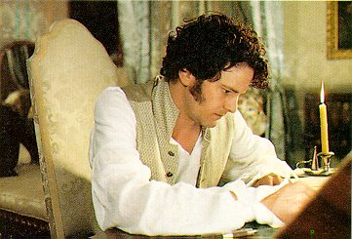
Mr. Darcy, angry and upset, decides to write a letter defending himself against accusations that Elizabeth leveled at him in her refusal of his offer of marriage. First, he defends himself against her accusations concerning Wickham.
He reveals that Wickham is a scoundrel who declined interest in the church and received a sum of 5000 pounds instead of the church living. In addition, Wickham tried to elope with Georgiana, Darcy’s sister, in order to gain access to her fortune of 30 000 pounds.
In the second part of his letter, Darcy explains that when he separated Bingley from Jane, he believed her to be indifferent to him. In addition, he objected to the want of propriety displayed by their mother, their younger sisters and, occasionally, even their father.

Slide 39
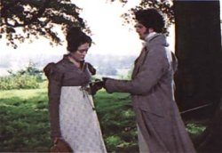
Upon receiving the letter, Elizabeth finds its contents difficult to believe. However, gradually she comes to understand Darcy’s point of view and her hate of him dissipates.
Elizabeth’s visit to the Hunsford parsonage is now at an end and she returns home to her family. Jane has also returned home from her trip to London but is still quite depressed. The news at home is that the militia currently stationed at the nearby town of Meryton is moving to Brighton.
The younger Bennet sisters are distressed at the news and long to visit Brighton. When Lydia, the youngest Bennet sister, receives an invitation to stay in Brighton with Mrs. Forster, the wife of the colonel of the regiment, she is ecstatic.

Slide 40

Summer arrives and Elizabeth is invited to take a tour of Derbyshire with her Aunt and Uncle Gardiner. While they are there, they decide to visit Pemberley, Darcy’s estate. Elizabeth refuses to go until she discovers that the family is away from home for the summer. Her source of information, however, is mistaken; Darcy is already on his way home from London.
Pemberley turns out to be a grand and beautiful estate with a magnificent house surrounded by a large park. Inside the house, they are taken on a tour by the housekeeper who has nothing but praise for Darcy. Elizabeth can hardly believe the housekeeper's words.

Slide 41
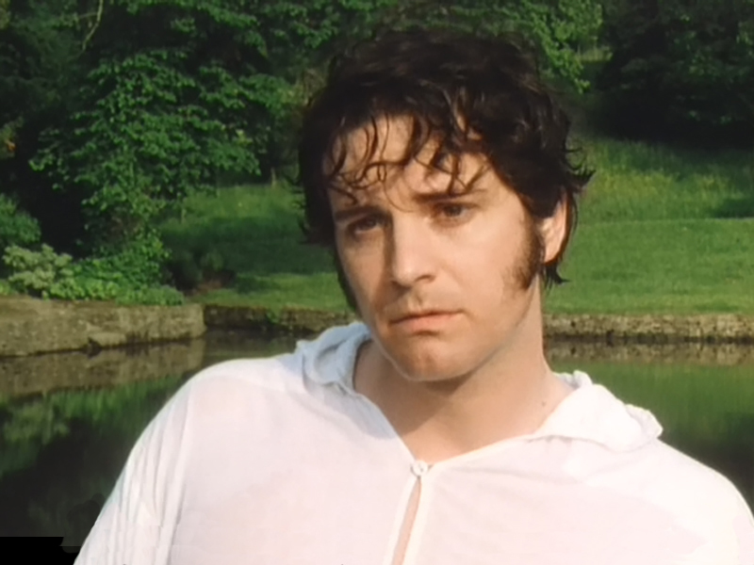
Meanwhile, Darcy has arrived at Pemberley and is taking a swim in his lake. Just as he is walking back to the house he stumbles upon Elizabeth who is exploring the park. Both are surprised and speechless. They exchange polite greetings before Darcy rushes off. Elizabeth is embarrassed and declares that they must leave immediately but before they reach their carriage, Darcy reappears.
He is friendly and open towards Elizabeth and the Gardiners. Elizabeth is astonished at the drastic change in his character. Darcy reveals that Georgiana, Mr. Bingley and Mr. Bingley’s sisters will arrive at Pemberley on the next day and they all part amiably.

Slide 42
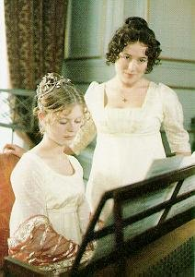
Mr. Darcy, Georgiana Darcy and Mr. Bingley visit Elizabeth at the Lambton Inn soon after their arrival at Pemberley. Georgiana turns out to be a shy, polite young girl to whom Elizabeth takes a liking. Mr. Bingley is his usual cheerful self and is delighted to see Elizabeth again. During their visit, Elizabeth and her Aunt and Uncle Gardiner are invited to dine at Pemberley the following evening.
The visit to Pemberley proceeds quite smoothly. Elizabeth and Georgiana take turns playing the piano. Caroline Bingley, out of spite towards Elizabeth, makes a reference to Mr. Wickham which distresses Georgiana but the situation is handled smoothly by Elizabeth.

Slide 43
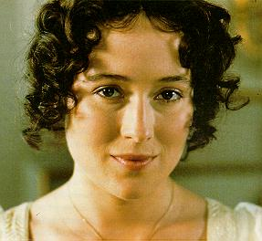
After Elizabeth leaves, Caroline and her sister, Mrs. Hurst, take turns criticizing Elizabeth’s appearance. Caroline, in particular, seems to be determined to do everything possible to lower Darcy’s high opinion of her. She provokes him until, finally, he retorts that he has considered Elizabeth to be one of the handsomest women of his acquaintance for many months.
The next day, Elizabeth receives two letters from Jane which bring alarming news. Lydia, her youngest sister, has eloped with Mr. Wickham. In addition, it is doubtful that Wickham has any intention of marrying her. They have disappeared without a trace and the only clue is that they may be hiding in London. While Elizabeth is recovering from shock, Mr. Darcy arrives for a visit. His thoughtful and gloomy reaction to her news of Lydia leads Elizabeth to believe that her sister’s elopement has brought disgrace to her whole family.

Slide 44
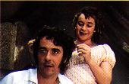
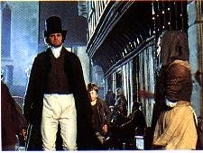
Meanwhile, Lydia, the object of all this commotion, is in a small, rundown suite in London with Wickham. She is as silly as ever and very proud of her success in catching Wickham. Wickham, on the other hand, is beginning to find her immaturity tiresome.
In another disreputable part of London, we see Mr. Darcy wandering the streets purposefully searching for something or someone. After much trouble, he locates the hideout of Wickham and Lydia.
A little later, Mr. Bennet receives a letter from Mr. Gardiner. Lydia and Wickham are not yet married but will be if Mr. Bennet agrees to certain conditions.

Slide 45
The terms of the engagement are much lighter than expected, leading Mr. Bennet to believe that Mr. Gardiner has paid a great deal of money to Wickham in order to bring about the marriage.
The successful resolution of Lydia’s elopement leads Elizabeth to regret that she initially confided in Darcy. She finds it difficult to bear that Mr. Darcy is alive in the world and thinking ill of her.
When Mrs. Bennet hears the news that Lydia and Wickham are to be married, she is overjoyed. Both daughter and future son-in-law are instantly forgiven and Mrs. Bennet can think of nothing but the happiness of having a daughter married.

Slide 46
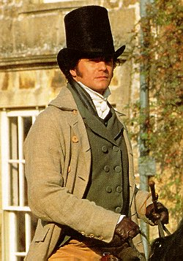
After Lydia is married, she and Wickham come to Longbourn for a visit before joining Wickham’s new regiment in the North. Lydia is unchanged. She remains wild, noisy and fearless, and expresses only pride in her elopement. When she accidentally lets it slip that Mr. Darcy was at her wedding, Elizabeth is wild with curiosity. She immediately writes to Mrs. Gardiner to demand an explanation.
Mrs. Gardiner returns the letter with one of her own expressing surprise at Elizabeth’s ignorance of Mr. Darcy’s role in uniting Lydia and Wickham. It turns out that Mr. Darcy was responsible, firstly, for finding Wickham, and then, for bullying and bribing him to marry Lydia.

Slide 47
Time passes and life continues as usual for the Bennet family after Lydia’s marriage until, one day, they discover that Mr. Bingley is returning to Netherfield for a shooting party. Bingley’s acquaintance with Jane is quickly renewed and he proposes to her shortly after. Bingley is accompanied by Darcy on most of his visits to Longbourn but Elizabeth is distressed when Darcy hardly even speaks to her.
Shortly after Bingley and Jane’s engagement, the Bennet family is surprised by a visit from Lady Catherine de Bourgh. It seems that Lady Catherine has heard a rumour that Elizabeth will soon marry Mr. Darcy, her nephew. She has come, therefore, to have the report universally contradicted and to gain a promise from Elizabeth never to enter into an engagement to Mr. Darcy. Elizabeth, of course, refuses to oblige her imperious demands.

Slide 48
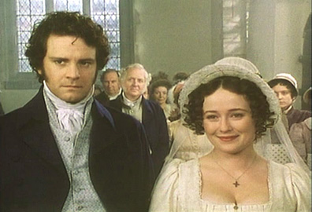
Lady Catherine’s objections to the marriage do not have their intended effect and in a few days, Mr. Darcy returns from London to Longbourn. In a walk together, Elizabeth and Darcy are reconciled and their engagement is formed.

Slide 49
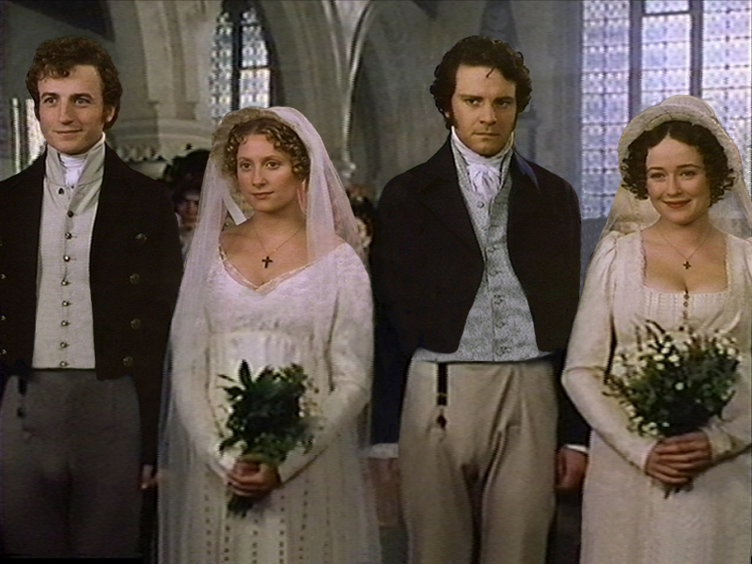
The story ends with a double wedding between Elizabeth and Darcy, and Jane and Bingley.

Slide 50
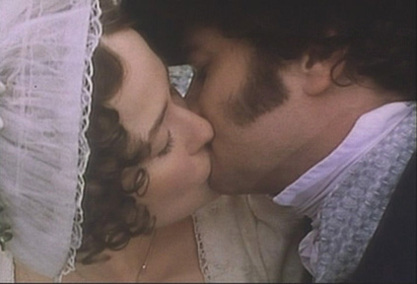
HOORAY!

Slide 51
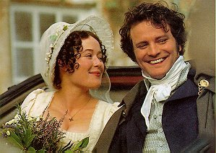
and they all lived happily ever after

Slide 52
The Story
in Bullet Points

Slide 53
Mr Bingley leases Netherfield Park.
Mr Darcy slights Elizabeth at a local ball.
Party at Sir William Lucas', Elizabeth refuses to dance with Mr Darcy.
Jane goes to Netherfield and catches cold.
Elizabeth goes to Netherfield to help; mother and sisters visit; Jane and Elizabeth leave a few days later.
Mr Collins' letter and arrival.
They all walk to Meryton and meet Mr Wickham. Darcy and Bingley meet the group.
Evening at Phillips'; Elizabeth dances with Darcy, mentions Wickham; Darcy becomes aware of family expectations for Jane and Bingley;
Collins bores Darcy; Mrs Bennet talks unwisely; Mary shows off; Bennet family last to leave.

Slide 54
Collins proposes to Elizabeth, rejected.
Netherfield party returns to London.
Collins proposes to Charlotte Lucas, accepted.
Mr and Mrs Gardiner visit and take Jane to London.
Wickham courts Miss King, an heiress.
Elizabeth, Sir William and Maria Lucas go to Hunsford via London to visit Charlotte.
Darcy and Colonel Fitzwilliam arrive at Rosings.
Lady Catherine deBourgh rude and condescending to everyone, especially Elizabeth.
Darcy proposes to Elizabeth, rejected.
Darcy's letter of explanation.

Slide 55
Darcy and Fitzwilliam leave.
Elizabeth, Maria and Jane return to Longbourne, meeting Kitty and Lydia on the way.
Elizabeth does not reveal what she has learned about Wickham.
Lydia invited by Mrs Forster to go with regiment to Brighton; Elizabeth advises against it but is ignored.
Elizabeth and Wickham talk of Darcy; Elizabeth hints that she knows the truth.
Elizabeth and Gardiners go to Derbyshire on holiday.
They visit Pemberley; housekeeper's positive report; Darcy appears.
Visit with Bingleys, introduced to Georgiana Darcy.
Letters from Jane about Lydia and Wickham's elopement.

Slide 56
Return to Longbourne; marriage of Lydia and Wickham arranged; Elizabeth learns of Darcy's involvement in this.
Bingley and Darcy return to Netherfield; Bingley proposes to Jane.
Lady Catherine arrives to threaten Elizabeth not to marry Darcy; letter from Collins warning against the same thing.
Darcy returns from London, proposes marriage, accepted.
Reactions of family to news.
Marriages of Charles Bingley to Jane and Darcy to Elizabeth.
The End

Slide 57
This powerpoint was kindly donated to www.worldofteaching.com
http://www.worldofteaching.com is home to over a thousand powerpoints submitted by teachers. This is a completely free site and requires no registration. Please visit and I hope it will help in your teaching.

